Slide 1
Exploratory Data Analysis of EMPLOYEE ATTRITION Using Python
By:
KAPARTHY ADIYOGESH – D22021
MAHESHKUMAR – D22027
MANALI SANDEEP PARAB – D22028

Slide 2

Goal of this project
PEOPLE WHO LEFT |  | 237 |  | 16%
PEOPLE WHO ARE WORKING |  | 1233 |  | 84%
TOTAL |  | 1470 |  | 100%
Factors affecting this attrition…..????
Dig deeper using PYTHON….!!!!

Slide 3
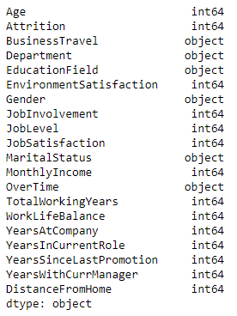
Over view of Data
EDA Process
Variables in Data set
Data Understanding
Data Exploration & Processing
Analysis
Uni Variant
Feature Selection
Bi Variant
Multi Variant
Visualization

Slide 4
Statement of Hypothesis
Do age play a major role in company turnover ?
Are employees leaving the company because of no hike ?
Are they gender biased, does it effect the salary distribution?
Which age group has more attrition ?
Are the employee travelling more are leaving the company ?
Do employee who stay long term in the same position would leave?
Are they biased based on marital status ?

Slide 5
Assumptions
Age - Younger staffs are leaving more frequently than more seasoned ones. The cause can be a lack of workplace compatibility or a desire for better chances.
Gender - The company environment may have gender bias that causes female employees to leave more frequently than male ones. The marital status of female employees may potentially be causing them to leave.
Job Satisfaction - The employee may quit their job if they are not happy with it.
Monthly Income - If employee monthly income is less than their expectation, they may consider leaving the position in search of a better opportunity.

Slide 6
Over Time - This metric is used to determine how many employees work overtime and if they get compensated for it.
Years In Current Role - To determine if an employee had a prolonged stay in the same position that would have contributed to attrition.
Years Since Last Promotion - To determine if the number of promotions given to workers is enough given their experience and qualifications.
Distance From Home - To see if the employee's commute from home is longer, as this increases the likelihood that he or she may leave the company.

Slide 7
Univariate analysis
 | Age | Attrition | Monthly Income | Total Working Years | Years at Company | Years In Current Role | Years Since Last Promotion | Years With Current Manager | Distance From Home
Count | 1470 | 1470 | 1470 | 1470 | 1470 | 1470 | 1470 | 1470 | 1470
Mean | 36.92 | 0.16 | 6502.93 | 11.28 | 7.01 | 4.23 | 2.19 | 4.12 | 9.19
std | 9.14 | 0.37 | 4707.96 | 7.78 | 6.13 | 3.62 | 3.22 | 3.57 | 8.11
Min | 18 | 0 | 1009 | 0 | 0 | 0 | 0 | 0 | 1
25% | 30 | 0 | 2911 | 6 | 3 | 2 | 0 | 2 | 2
50% | 36 | 0 | 4919 | 10 | 5 | 3 | 1 | 3 | 7
75% | 43 | 0 | 8379 | 15 | 9 | 7 | 3 | 7 | 14
Max | 60 | 1 | 19999 | 40 | 40 | 18 | 15 | 17 | 29

Slide 8
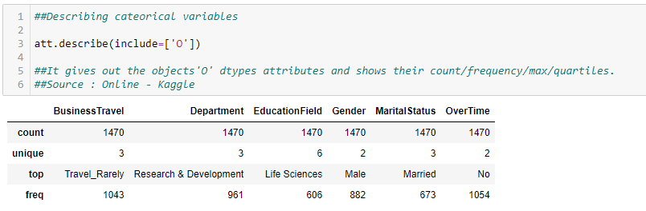
Univariate analysis

Slide 9
Univariate analysis insights
In this Company,
The average age of employee is nearly 37 years and ranges from 18 to 60 years.
It is observed that 961 employees from the Research & Development department, 63 from the HR department, and 446 from the Sales department were either working or left.
70% of the total employees are rarely travelling for Business works are either working or left.
30% of the employees are highly satisfied with the Office Environment,
19% of employees are less satisfied with their Job role are either working or left.
The monthly income of employees are found to be in range of 1000 to 20000, majority of employees salary are found to be slightly less than 8400.
Most of the employees are having a total work experience of 5 to 10 years, whereas the maximum work experience of 40 years either working or left the company.

Slide 10
Univariate analysis insights
There are 882 Males and 588 Females are either working or left.
It is found that, 50% of the employees are within 7 km radius to the company
In this company it is observed that only a very few employee do business travel regularly.
In this company it is observed that majority of employee work in Research & Development.
In this company it is observed that majority of employee have an educational qualification in life sciences .

Slide 11
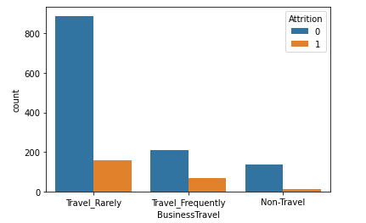
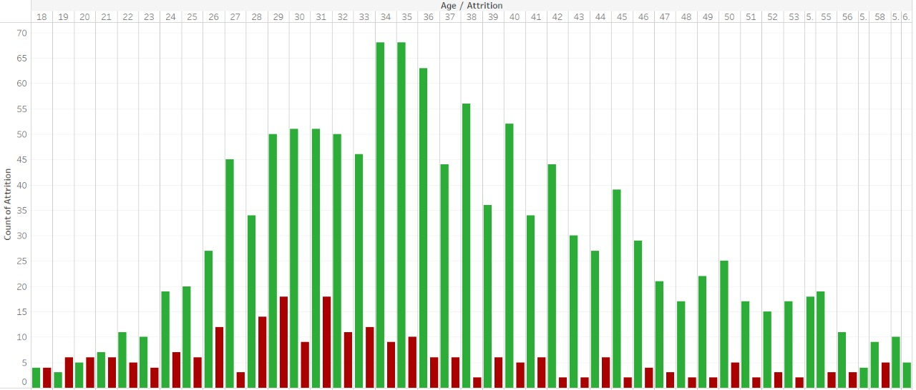
Bivariate analysis
AGE vs. Attrition
Business Travel vs. Attrition
Under our analysis, it is found that proportion of employees who left was high in young employees whose age ranges from 18-30 years. The employees who are nearing their retirement age are more likely to stay in the company.
As per our analysis, it is found that employees those who travel frequently are more likely to leave the company

Slide 12
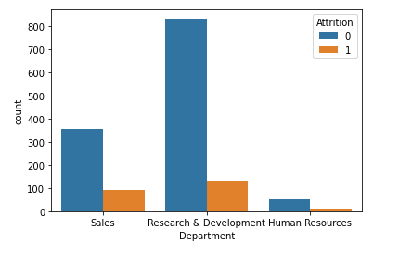
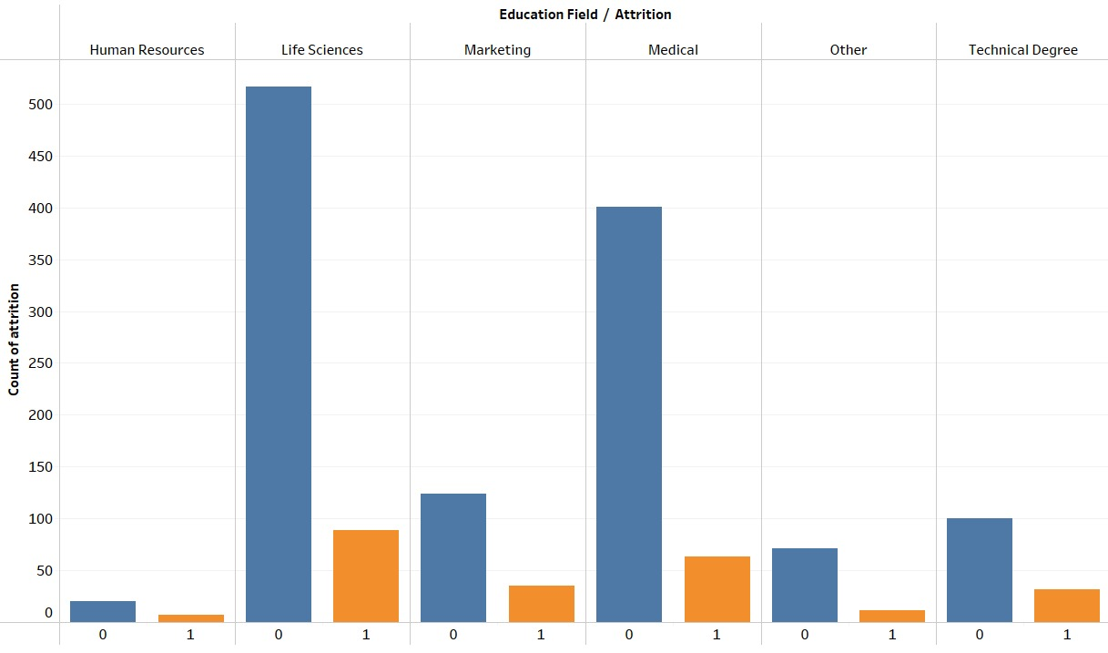
Bivariate analysis
Department vs. Attrition
Education Field vs. Attrition
From our analysis, it is found that the attrition rate is almost same for HR Department and Sales Department. Hence it seems that there is no significant relation between department and attrition.
From our analysis, it is found that

Slide 13
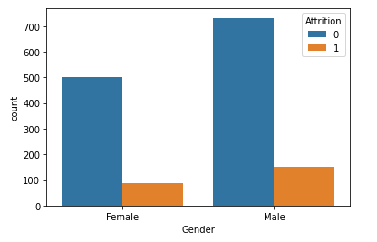
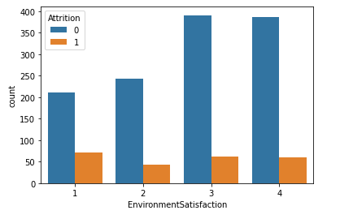
Bivariate analysis
Gender vs. Attrition
Environment satisfaction vs. Attrition
As per our analysis, it is found that gender is not affecting attrition
From our analysis, it is found that lower the
Environment satisfaction more the attrition.

Slide 14
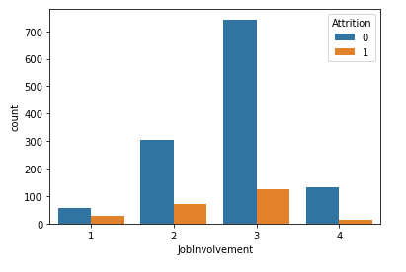
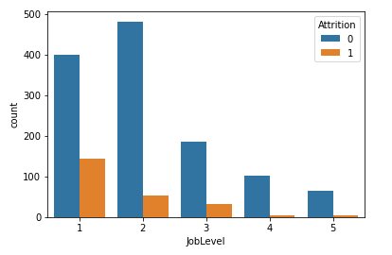
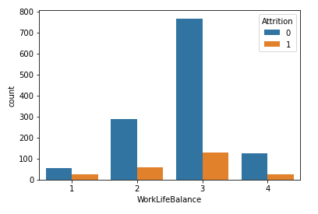
Bivariate analysis
Job Involvement, Job Level, Work life balance vs. Attrition
From our analysis, it is found that lower job involvement, lower job satisfaction and lower work-life balance of employees leads to higher attrition rate.

Slide 15
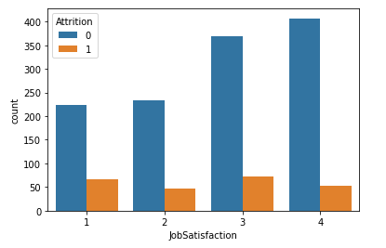
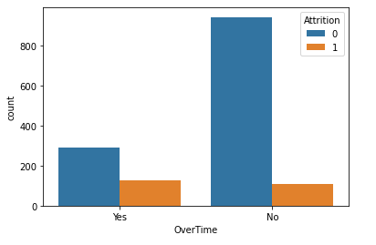
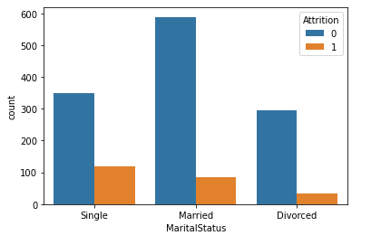
Bivariate analysis
Job Satisfaction, Over time, Marital Status vs. Attrition
As per our analysis, it is found that
As per our analysis, it is found that people doing over time are likely to leave the company
As per our analysis, it is found that

Slide 16
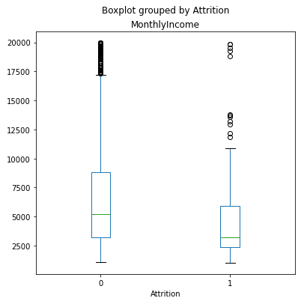
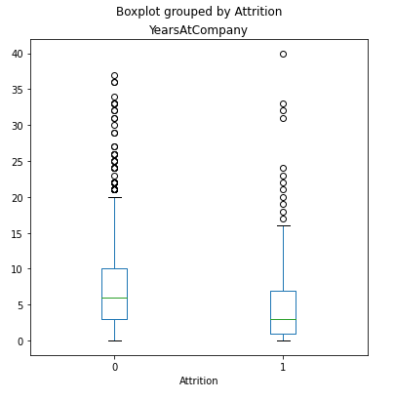
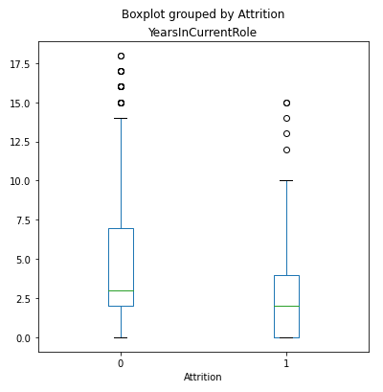
Bivariate analysis
Monthly Income, Years in Company, Years in Current Role vs. Attrition
As per our analysis, it is found that
As per our analysis, it is found that
As per our analysis, it is found that 75 % of employees who left the company are getting salary less than 6000.

Slide 17
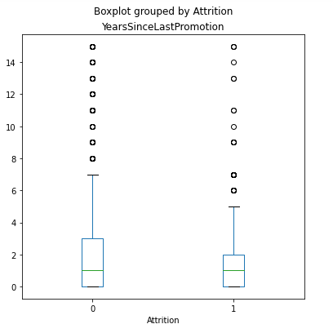
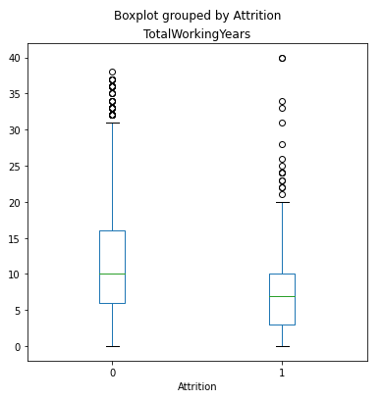
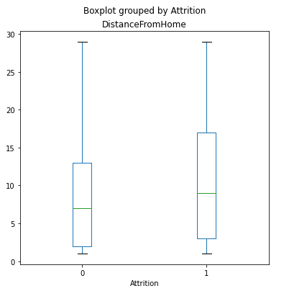
Bivariate analysis
Last Promotion, Working Years, Distance from Home vs. Attrition
As per our analysis, it is found that as promotion
As per our analysis, it is found that employees having less total working years have attrition
As per our analysis, it is found that distance does not affecting

Slide 18
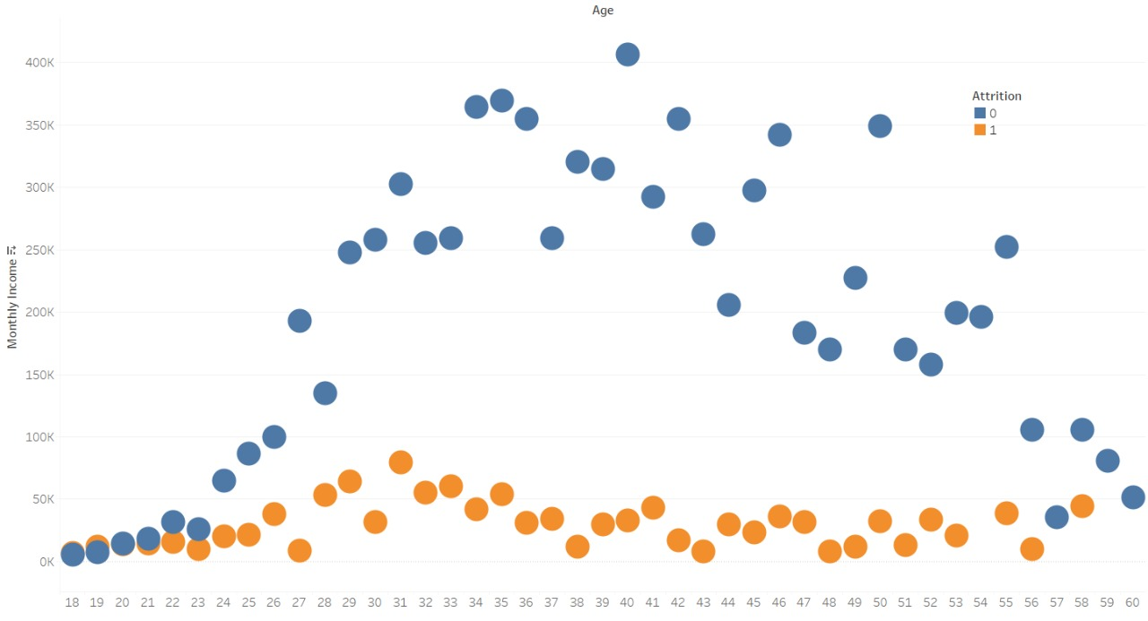
Multivariate analysis
From the analysis it is observed that employee getting lower income are leaving the company

Slide 19
Multivariate analysis insights
As per our analysis, it is found that the females seem to have almost twice the attrition rate as of the males in HR department.
As per our analysis, it is found that the female employees working in R&D Department are more likely to stay in the company
As per our analysis, the employees who are doing overtime and less involved in the work are more likely to leave the company
High Prop of attrition is happening in sales department who are doing over time
As Per our Analysis, it is found that employees those who are unmarried and doing overtime are more likely to leave the company

Slide 20
Python Colaboratory File Link
https://colab.research.google.com/drive/18gDNm7soCCcaf2xyTQCteAwheBTFVtu0?usp=sharing

Slide 21


